Slide 1
"Working with Reluctant and Resistant Teachers of Students with Behavior Disorders "
Dr. Edward Schultz PhD
Midwestern State University

Slide 2
Context and Some Thoughts
Teacher shortage, teacher burn-out, teachers in many cases are less trained and charged with working with kids with the most complex needs.
Kids ARE tougher and many teachers report parent support is declining.
Social media, social media, social media
Kid behavior is easier to change than adult behavior
There is no more noble profession or “calling” as being a teacher, especially one who teaches kids with emotional and behavior disorders.

Slide 3
Over-View
Understanding General Education Teachers
Concrete strategies.

Slide 4
Understanding the Teacher-Student Dynamic
“Forced” relationship
Negative cycle
Self-fulfilling prophecy
Triangulation
Power Dynamic
Chronic Conflict

Slide 5
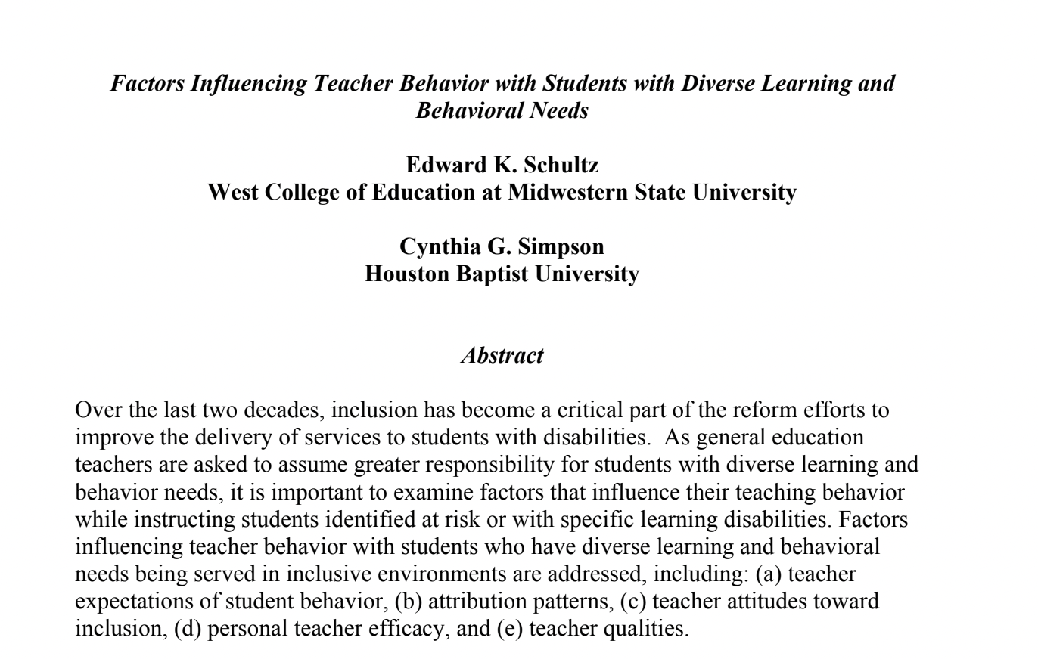

Slide 6
How do teachers feel when students are acting out? (Axup & Gersh, 2008)

Slide 7
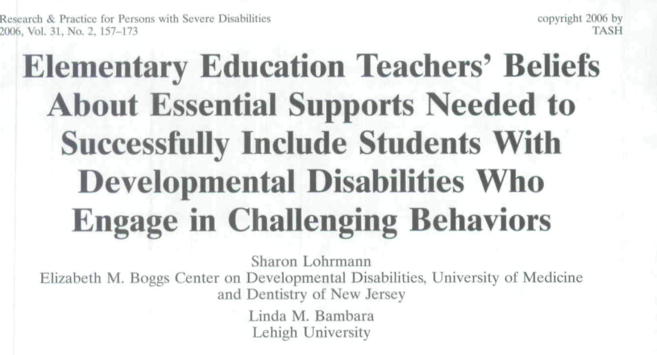

Slide 8
Results
General Ed Teachers initial impressions about including students with Behavior disorders? Fear, anxiety, worry, and scared.
Sped teachers were reported to have more confidence.
Struggles included: Student centered, Parent Conflict ,(worried about their kid with other kids), other teachers (had to be “peacemakers”)
Two levels of support were reported: a) school-wide support and b) situation-specific reports.
Wanted more collaboration, assistance from admin, parent support

Slide 9
So what do we do?
Here is what works-
Provide feedback on their practices (Flores, et al. ”praise”) using data.
“Good Behavior Game” had significant impact on teacher behavior.
Help them understand the “function” of kid’s behaviors and include them when you are doing an FBA and teach the BIP. (next slide)
Get administration involved in increasing efficacy.
Show them progress monitoring

Slide 10
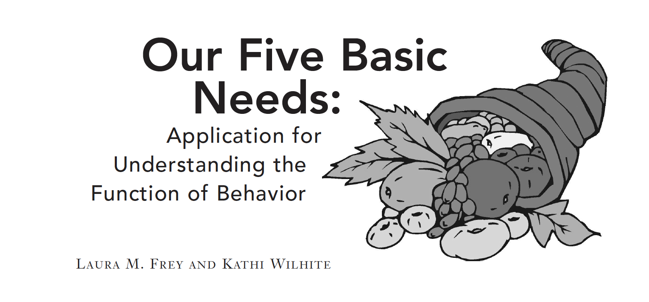
Survival
Belonging
Power/Self Worth
Freedom-
Fun

Slide 11
Collaboration and Coaching
Some studies show that 20% of teachers are resistance to coaching
1. Form a Relationship
2. Understand the Resistance
3. Ask Questions
4. Be Transparent
5. Acknowledge Efforts and Build Trust
https://info.teachstone.com/blog/5-coaching-strategies-teachers

Slide 12
Questions?
Edward.schultz@msutexas.edu

